Slide 1

DATA SCIENCE PROJECT PRESENTATION
Project Title: Gemineye Jewelry Price Prediction
Project by TEMITOPE AKANDE
Date: 17TH FEB 2025

Slide 2
Objectives
To perform exploratory data analysis (EDA) on jewelry price data
To develop predictive models for price estimation
To evaluate and deploy the best-performing model

Slide 3

Introduction & Problem Statement
Background: Jewelry pricing varies based on multiple factors such as material, brand, and gemstones. Predicting prices accurately can aid businesses and customers in making informed decisions.
Problem Statement: The challenge is to develop a machine learning model that accurately predicts jewelry prices based on given attributes.
Business Impact: Helps e-commerce platforms, retailers, and manufacturers optimize pricing strategies and enhance customer satisfaction.

Slide 4
Source: Jewelry dataset containing multiple attributes
Key Features:
Order Datetime, Product ID, SKU Quantity
Category, Brand, Price (target variable)
User demographics, Material, Gemstones
Data Size & Shape:
95910 rows, 13 columns
Category_ID (5,352), Category (9,933), Brand_ID (4,785), Price_USD (5,352), and User_ID (5,352) have missing values, indicating incomplete transactional records.
Target_Gender (48,167) has the highest missing count, suggesting it may not be consistently recorded.
Main_Color (7,660), Main_Metal (5,462), and Main_Gem (34,058) have missing values, potentially affecting the model’s ability to use these features for prediction.
Dataset & Data Collection

Slide 5
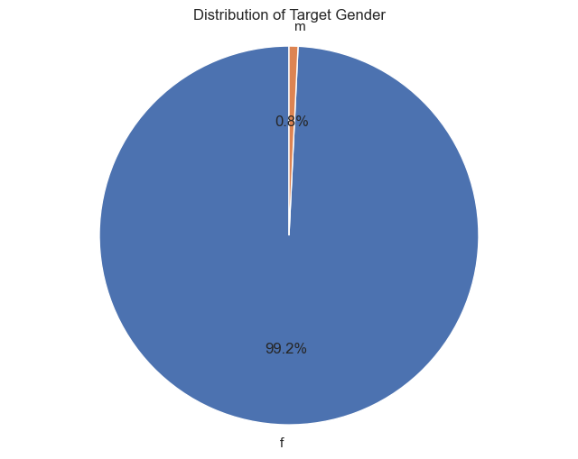
Distribution of Target Gender
Exploratory Data Analysis (EDA)

Slide 6
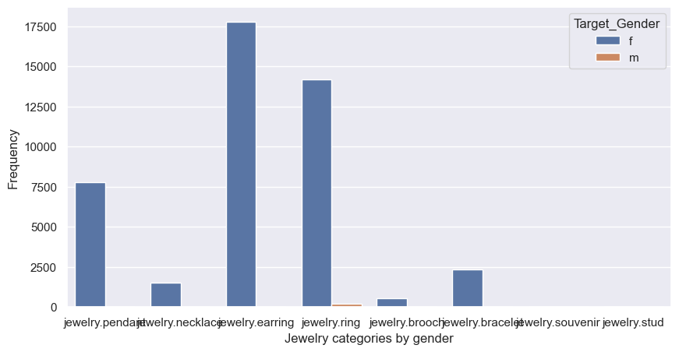
Jewelry Categories by Gender
Exploratory Data Analysis (EDA)

Slide 7
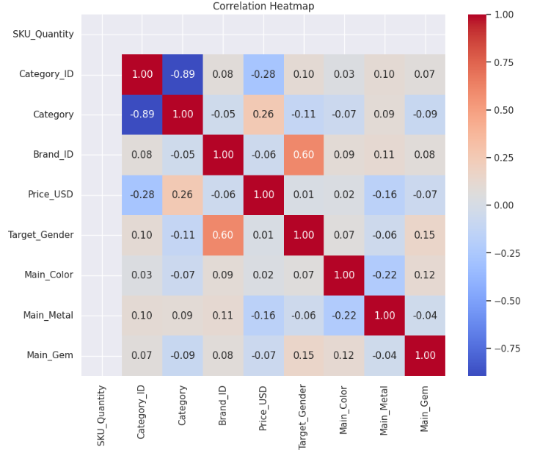
Exploratory Data Analysis (EDA)
Correlation Analysis: Identifying features that impact price

Slide 8
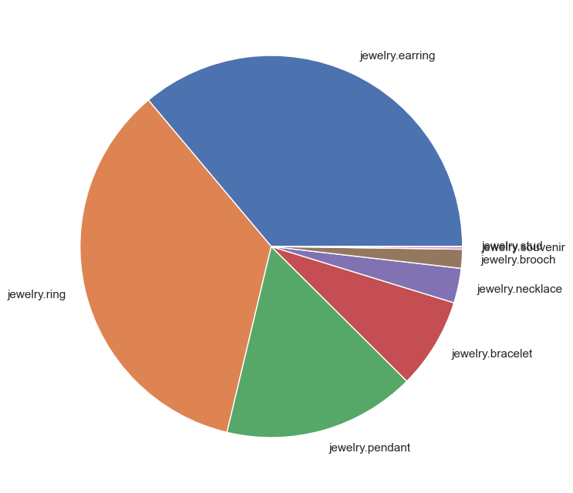
Exploratory Data Analysis (EDA)
UNIQUE CATEGORIES
jewelry.pendant jewelry.necklace jewelry.earring jewelry.ring jewelry.brooch jewelry.bracelet jewelry.souvenir jewelry.stud

Slide 9
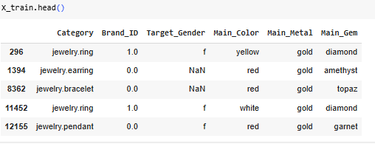
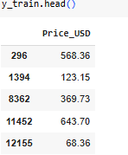
Handling Missing Values: Imputation techniques
Feature Engineering: Creating new meaningful features
Encoding & Scaling: Converting categorical data into numerical format
Train-Test Split: Splitting data for training and evaluation
Data Preprocessing
(64366, 6) After Transformation
(80458, 6) Before Transformation

Slide 10
Models Tested:
CatBoost, Linear Regression, AdaBoost, ExtraTrees
Hyperparameter Tuning: Optimizing model performance
Evaluation Metrics: R² score, RMSE
Model Selection & Implementation

Slide 11
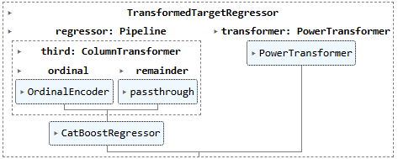
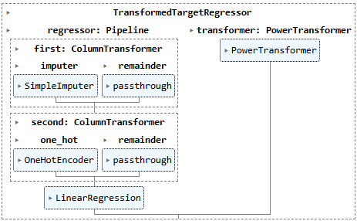
MODEL TESTED

Slide 12
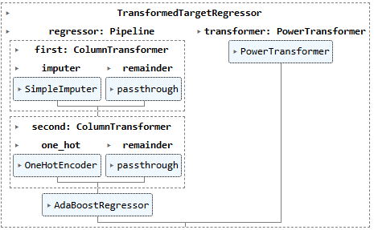
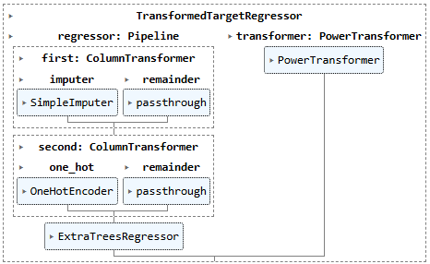
MODEL TESTED

Slide 13

Model Evaluation & Results
Best Model: Performance comparison of all models
Each model is evaluated using R² score (higher is better) and RMSE (Root Mean Squared Error) (lower is better). The generalization error (difference between train and test scores) indicates how well the model generalizes to unseen data.
Test CatBoost
test_model(cat_pipe, data_, metric_name, metric_function)
Train R2: 0.3114054606485469
Test R2: 0.34617897409449616
Generalization error = -0.034773513445949256
Train RMSE: 369.8060623569637
Test RMSE: 337.57121794239276
Generalization error = 32.234844414570944
CatBoost has the highest R² score among all models, meaning it explains more variance in jewelry prices. It also has the lowest RMSE, indicating lower prediction error.
Test LinearRegression
test_model(lin_pipe, data_, metric_name, metric_function)
Train R2: 0.06759651860544269
Test R2: 0.08226560399719751
Generalization error = -0.014669085391754821
Train RMSE: 430.32262691403724
Test RMSE: 399.93966067397173
Generalization error = 30.382966240065514
Linear Regression performs poorly, with very low R² and high RMSE. It fails to capture complex relationships in the data.

Slide 14
Model Evaluation & Results
Best Model: Performance comparison of all models
Test AdaBoost
test_model(ada_pipe, data_, metric_name, metric_function)
Train R2: 0.07015205622702947
Test R2: 0.07941602997841402
Generalization error = -0.009263973751384547
Train RMSE: 429.7325067359208
Test RMSE: 400.56008766238455
Generalization error = 29.172419073536275
AdaBoost's performance is similar to Linear Regression, with low R² and high RMSE. It does not provide significant predictive power.
Test ExtraTrees
test_model(extra_pipe, data_, metric_name, metric_function)
Train R2: 0.07015205622702947
Test R2: 0.07941602997841402
Generalization error = -0.009263973751384547
Train RMSE: 429.7325067359208
Test RMSE: 400.56008766238455
Generalization error = 29.172419073536275
ExtraTrees performs identically to AdaBoost, indicating it does not add much value for jewelry price prediction.

Slide 15
Model Evaluation & Results
Best Model for Deployment: CatBoost
Highest R² (0.3462) → Explains more variance
Lowest RMSE (337.57) → More accurate predictions
Acceptable generalization error → Better performance on unseen data
CatBoost is the best model for deployment due to its superior performance in capturing relationships and minimizing errors.

Slide 16

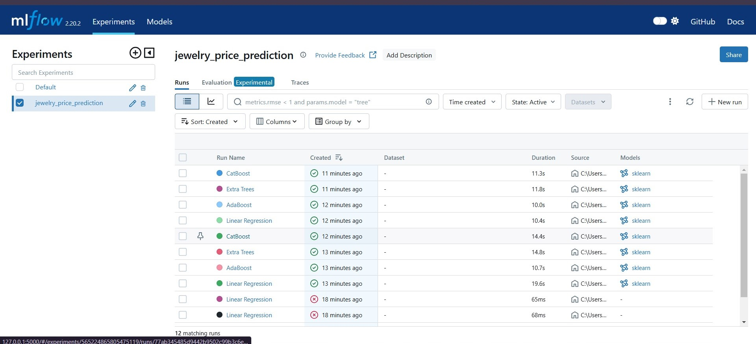
MLflow Tracking
Tracking Experiments: Recording model performance metrics
Comparing Runs: Analyzing improvements
Logging Parameters: Ensuring reproducibility

Slide 17

Challenges & Limitations
The jewelry pricing models faced issues due to:
Significant missing data: requiring imputation and potentially impacting accuracy.
Poor model performance: with low R² scores, indicating limited predictive power.
Low feature importance: of some variables, diminishing their contribution.
Generalization problems: suggesting a need for improved feature engineering to create more robust models.

Slide 18

Conclusion & Key Takeaways
Feature Distribution:
The dataset contained a large number of unique values for Order_ID, Product_ID, and User_ID, while categorical features like Main_Color and Main_Metal had limited variability.
Best Model:
CatBoost performed the best with an R² score of 0.3462 and the lowest RMSE (337.57), making it the best candidate for deployment.
Data Insights:
Price variations were influenced by factors like Brand, Category, and Metal Type, though additional features could improve prediction accuracy.

